Slide 1
Introduction
Advanced Graphics Programming

Slide 2
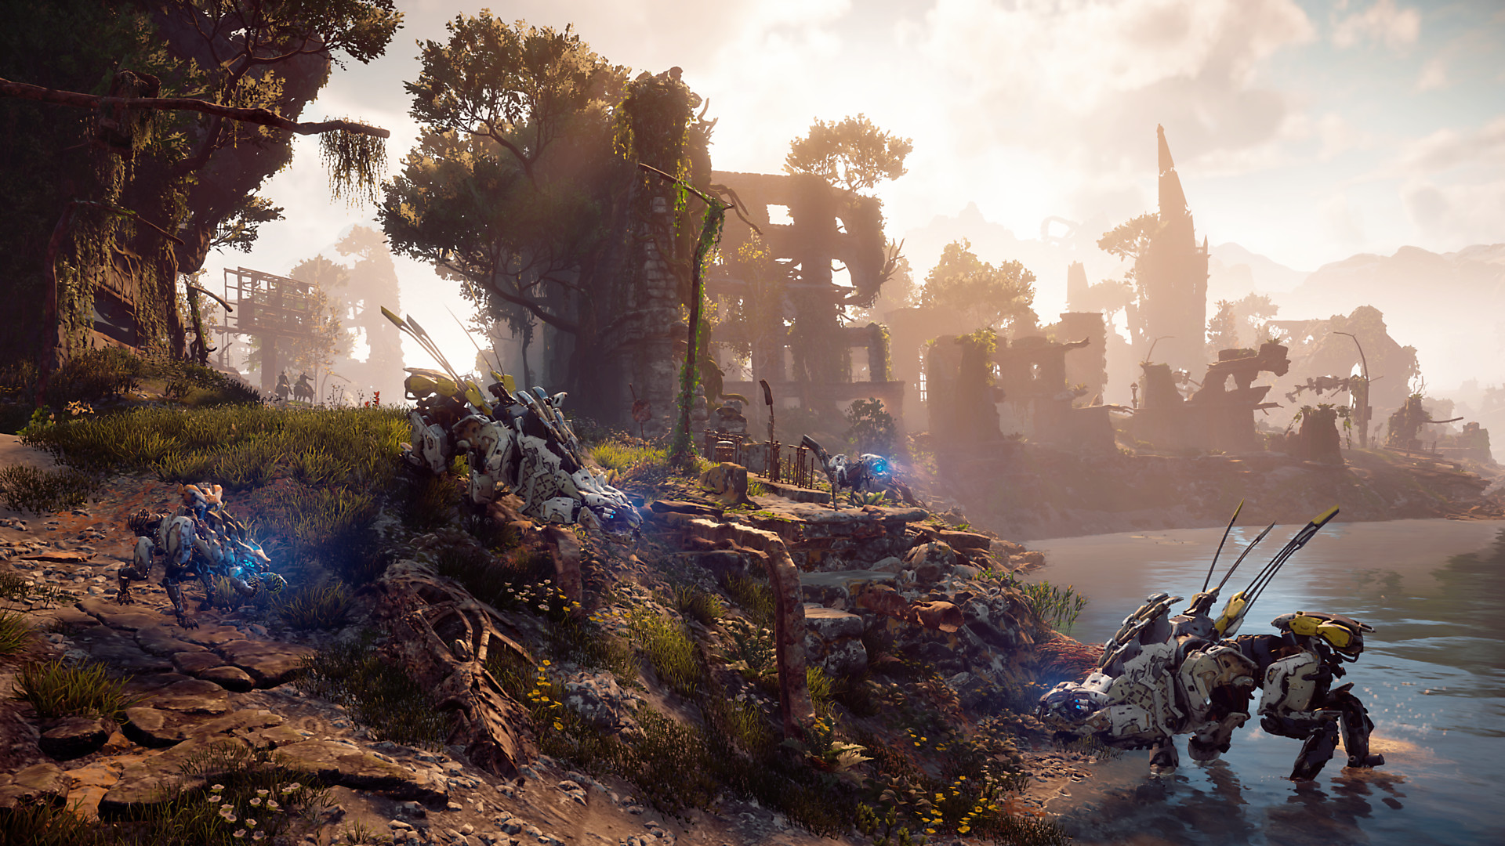
About AGP
Learning goals
What we will learn
Methodology
Evaluation
Tools
Image from Horizon Zero Dawn

Slide 3
Learning goals
Extending our knowledge of GPU’s capabilities at a lower level (Already introduced in other subjects)
Develop our skills in GPU programming with OpenGL and GLSL (Bye bye OpenGL < 3.3)
Learn to implement advanced computer graphics techniques (Using OpenGL of course, some techniques actually used in AAA games)

Slide 4
What we will learn
Shader programming
(Math tools / raycasting)
OpenGL foundations revisited
(Shaders / transforms / meshes / textures / framebuffers / tools…)
Advanced computer graphics techniques
(lighting, deferred shading, bump mapping, env. mapping, bloom, SSAO, PBR, etc…)

Slide 5
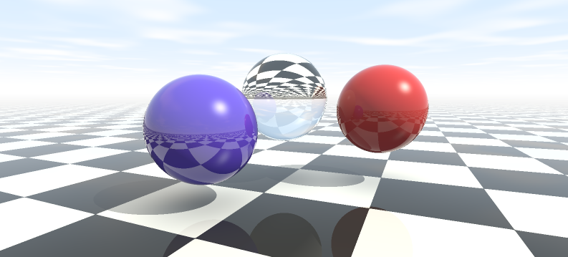
What we will learn (GLSL programming & raycasting foundations)

Slide 6
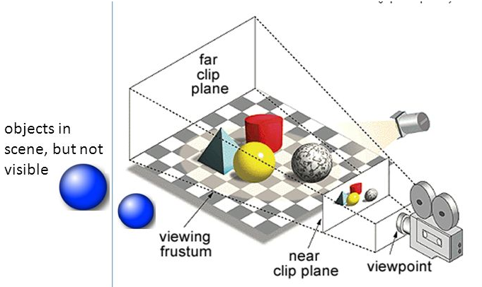
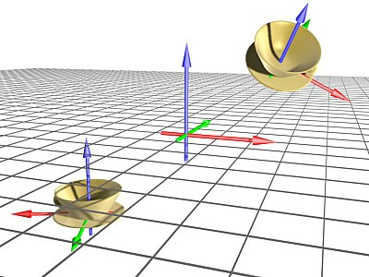
What we will learn (review of scene transforms, visibility, etc)

Slide 7
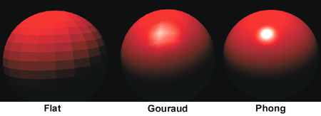
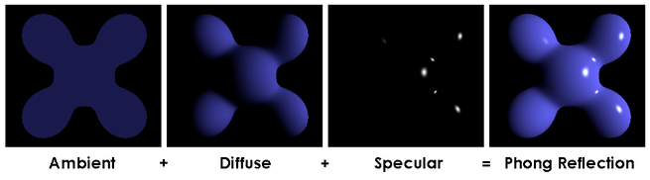
What we will learn (review of basic materials and shading)

Slide 8
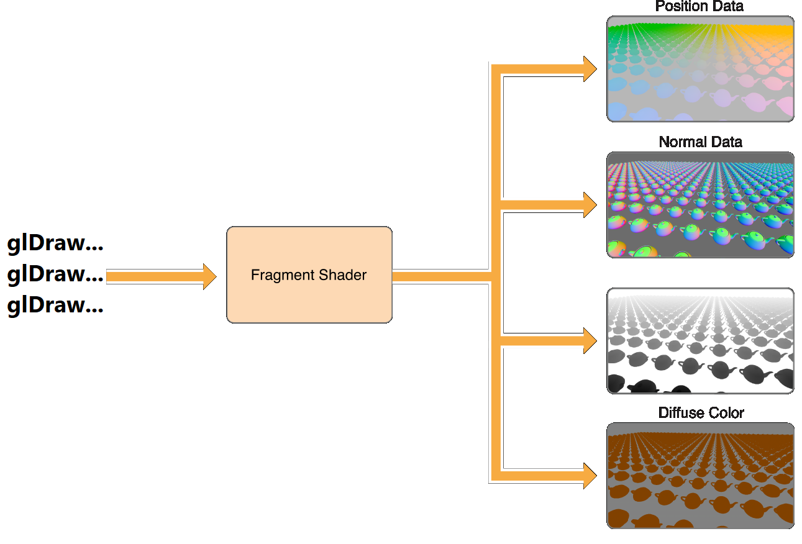
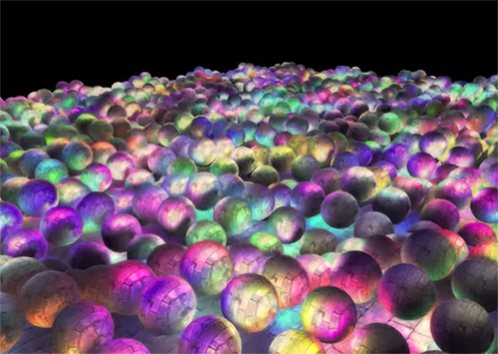
What we will learn (deferred shading)

Slide 9
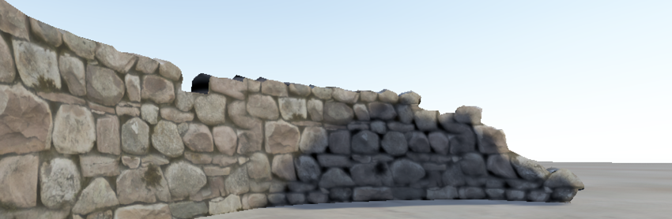
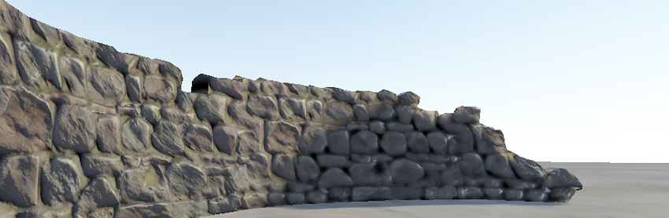
What we will learn (bump mapping techniques)

Slide 10
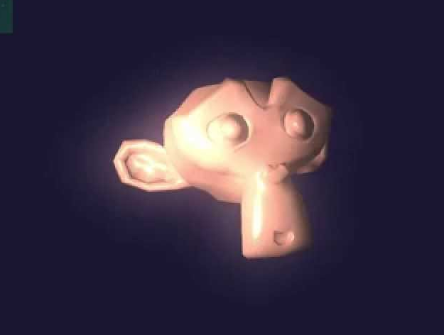
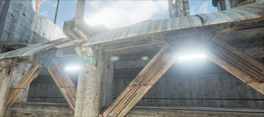
What we will learn (bloom/glow effects)

Slide 11
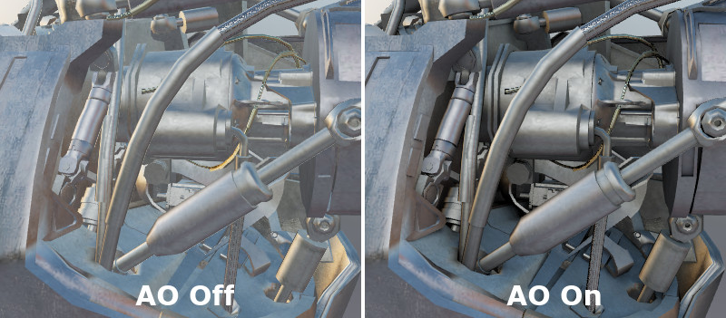
What we will learn (simulation of ambient occlusion)

Slide 12
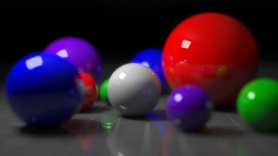
What we will learn (depth of field effect)

Slide 13
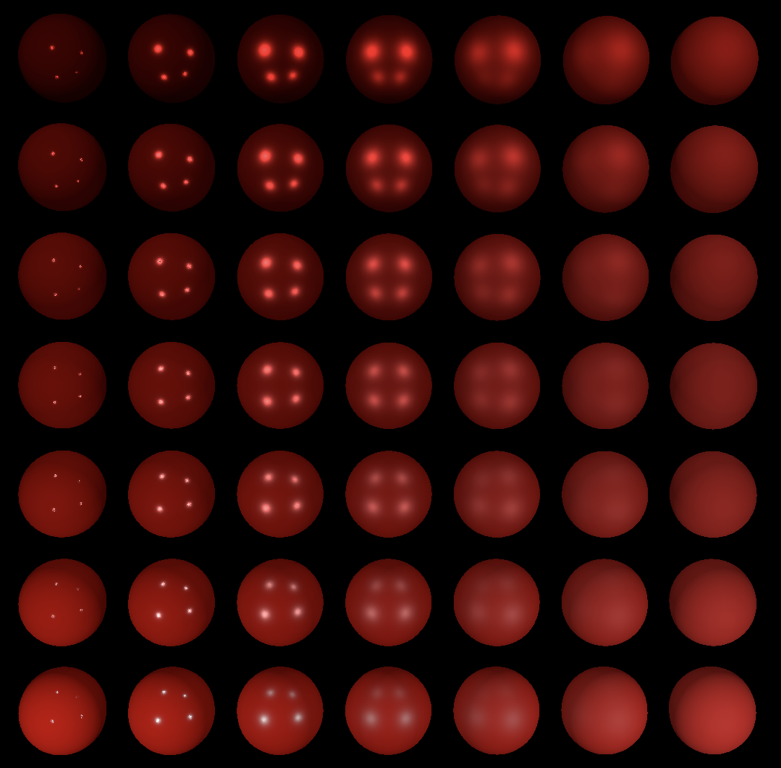
What we will learn (physically based materials)

Slide 14
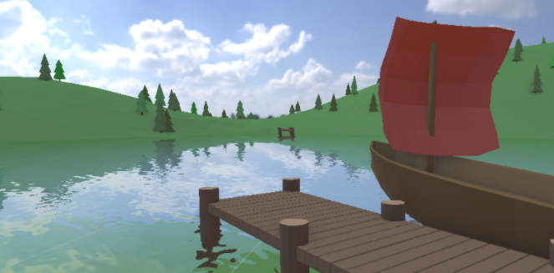
What we will learn (simulation of a water plane)

Slide 15
Methodology
2h sessions
30-60 min (approx.) explanations
Quick break
Hands-on learning the rest of the time
Material
Annotations on the board (virtually)
Slides / documents / links in the ATENEA campus

Slide 16
Evaluation
No exams in this subject… Hooray!
But… get ready to code
Deliverable 1 counts 30 %
Deliverable 2 counts 30 %
Final project counts 30 %
Participation / attendance counts 10 %

Slide 17





Tools
C++ (of course)
GLFW (Platform abstraction)
OpenGL / GLSL (GPU programming)
STB (To read/write image files)
GLM (OpenGL-like math lib)
Assimp (Asset Import library)
RenderDoc (Your life-saver, you’ll see)
ASSIMP

Slide 18
Questions?

